Slide 1

Prediction of profitable entry for high momentum stocks using machine learning
Lenin Kamma
Bellevue University
Professor: Catie Williams

Slide 2
Research Goal
Measure daily price fluctuations of momentum stocks
Predict the profitable entry for three momentum stocks (Shopify, Tesla, and Amazon)

Slide 3
Data Source
Historical stock prices are available at Yahoo finance website
Data extracted for all three stocks

Slide 4
Data Features
1260 records of Shopify stock data
2600 records of Tesla stock
2200 records of Amazon stock
Extracted 7 different features

Slide 5
Data Analysis
No duplicate data in the input
No null values are found
All are numerical values

Slide 6
Methods
Histograms, bar charts and scatter plots
Linear regression model
Measured predicted and actual values

Slide 7
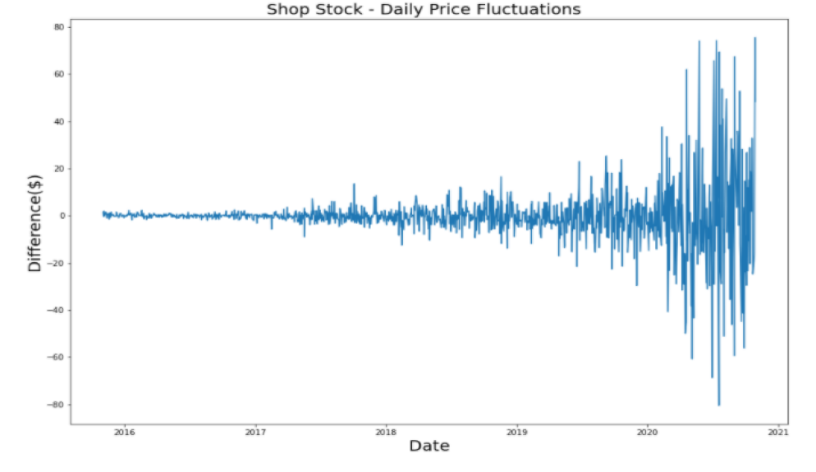
Shopify daily price fluctuations $5 to $60

Slide 8
Amazon daily price fluctuations $5 to $200

Slide 9
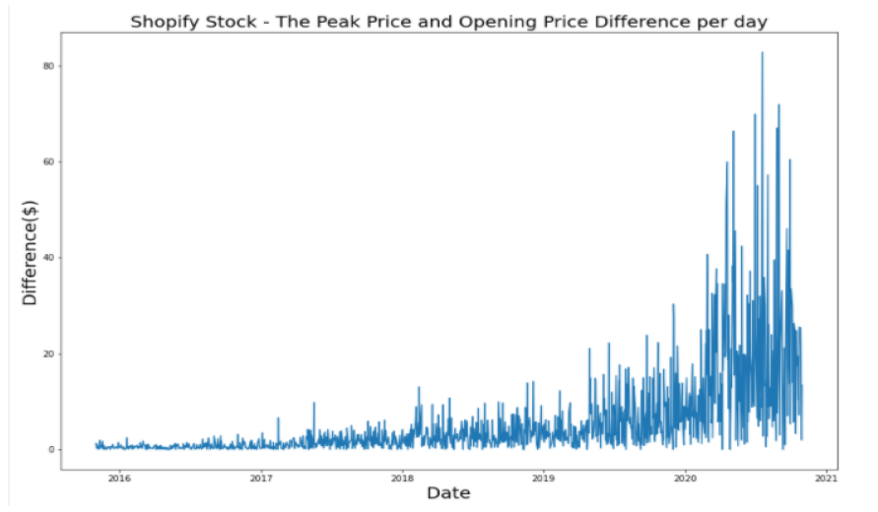
The delta between the opening price and peak price is on the rise

Slide 10
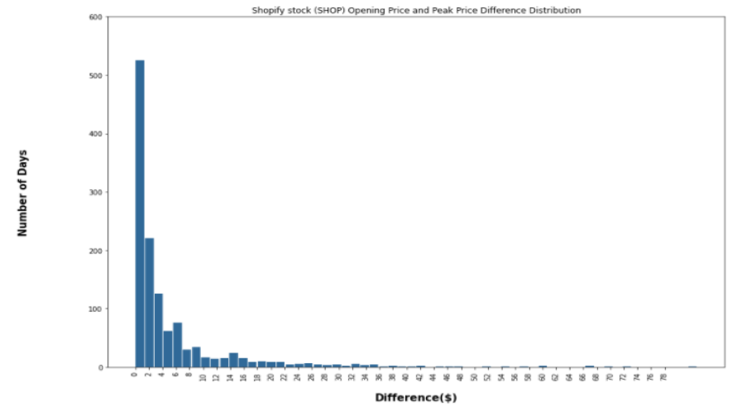
The delta distribution is not uniform

Slide 11
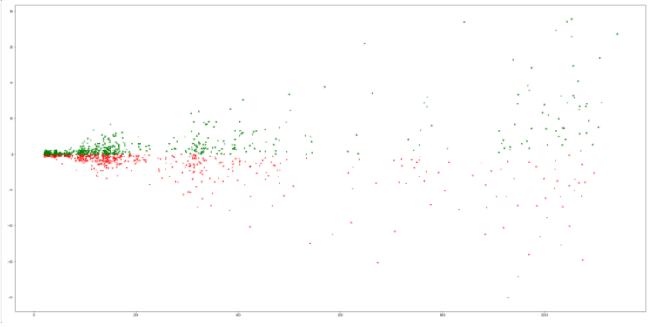
Profit and loss distribution – Shopify stock

Slide 12
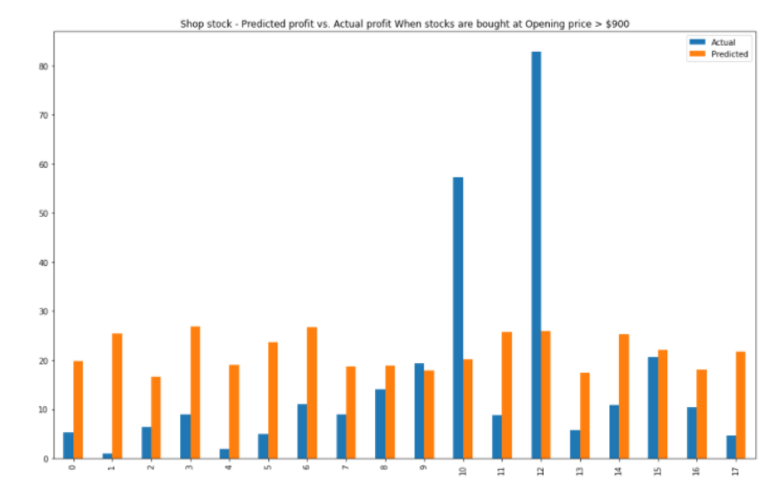
Predicted profit vs Actual profit – Shopify stock

Slide 13
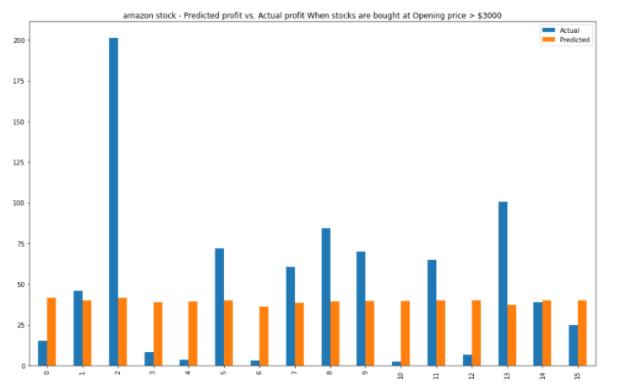
Predicted profit vs Actual profit – Amazon stock

Slide 14
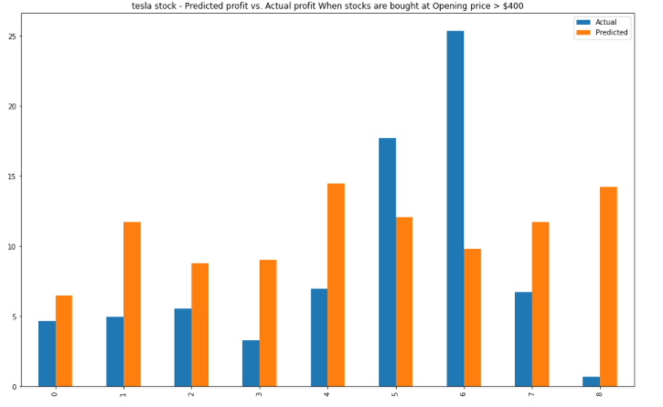
Predicted profit vs Actual profit – Tesla stock

Slide 15
Results-1
The daily price fluctuations for these three stocks.
The price range of Tesla is found to be +/-$5 to +/-$20,
Amazon +/-$10 to +/-$200
Shopify +/-$5 to +/-$80 per day

Slide 16
Results-2
Shopify, Tesla, and Amazon stocks are part of high momentum stocks
Profit can be made in the order of $5 to $ 40 per stock if entered at appropriate price
The prices of the stocks are reaching new highs

Slide 17
Conclusions - 1
If Shopify stock price is greater than $500.00
When stock is bought at the opening price and sold at the peak price
The predicted mean profit - $20.30
The actual mean profit - $16.20

Slide 18
Conclusions-2
If Amazon stock price is greater than $3000.00
When stock is bought at opening price and sold at peak price
The predicted mean profit - $44.00
The actual mean profit - $34.30

Slide 19
Disclaimer
These observations are based on the stock history and the linear regression model
Not a financial advise

Slide 20
Acknowledgements
Thank you
Professor Catie Williams for Feedback
Classmates for their reviews

